Slide 1

Ruby on Rails

Slide 2
About today…
Ruby on Rails
cancancan : User Authorization

Slide 3

CanCanCan
User Authorization

Slide 4

Introduction to Role-Based Authorization
Purpose
Authorization restricts access to resources based on user roles
Solution
CanCanCan is a popular authorization library for Rails

Slide 5



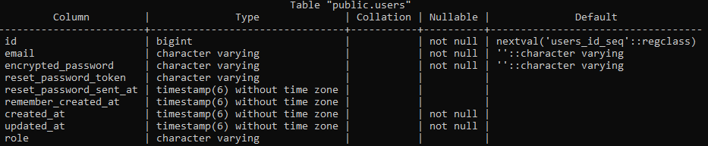
Creating space to add Roles
Generate a Migration to Add Role
Run the Migration
Verify column update in database

Slide 6
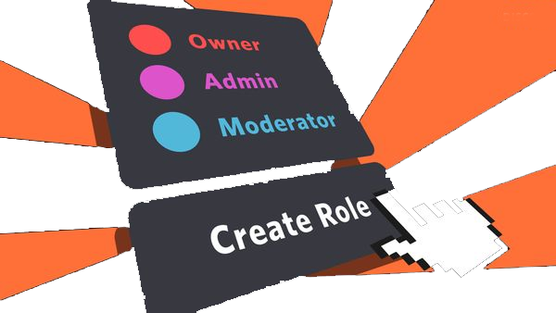
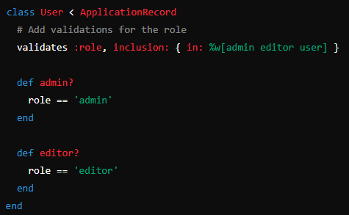
Adding Roles
Update User Model

Slide 7
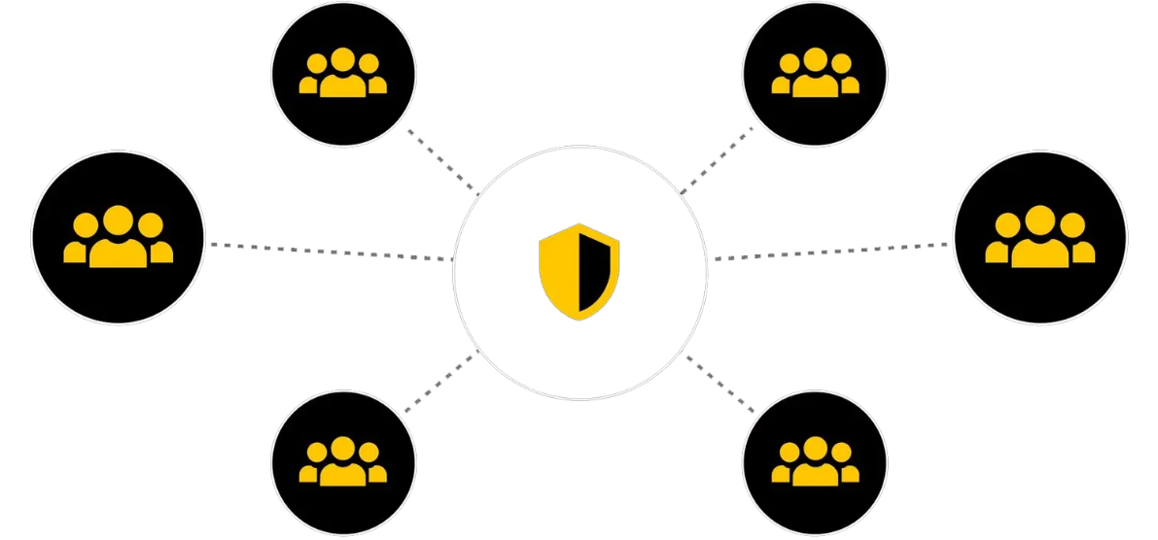
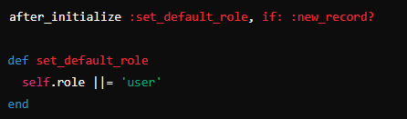
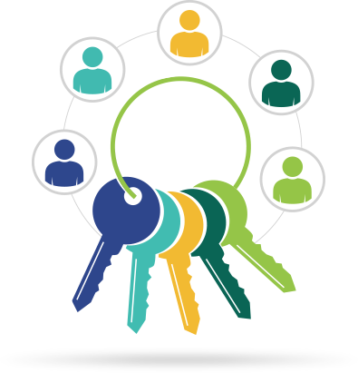
Setting default role
Set Default Role in User Model

Slide 8



Add CanCanCan to Gemfile
Save the file and then run

Slide 9


Setting Up CanCanCan
Run the Devise generator to set up its configuration and models
This command will create an ability file (app/models/ability.rb) where you can add ability for every user what he is authorized to do

Slide 10
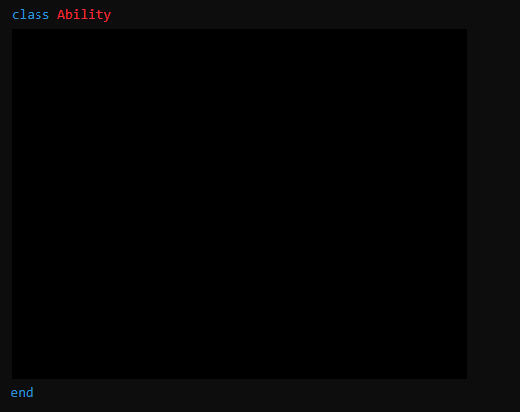
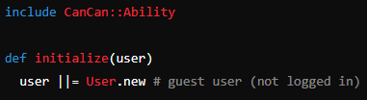
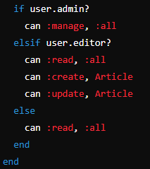
Define Abilities
Define Abilities in app/models/ability.rb

Slide 11

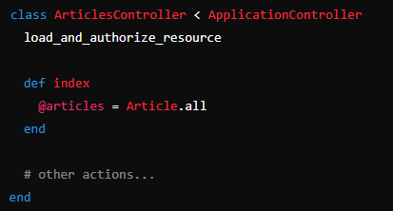
Authorize Controller Actions
Example

Slide 12

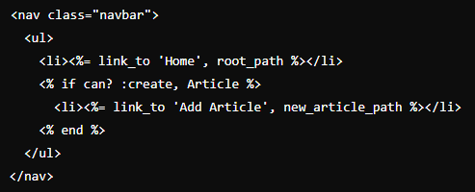
Restricting Access in Views
Conditional Display Based on Roles
Show "Add Article" link only for admin

Slide 13


Testing Role-Based Authorization
Creating Users with Different Roles
Use Rails console to create users

Slide 14

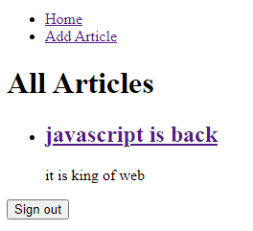
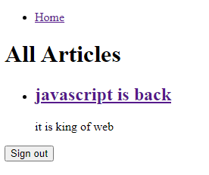
Start rails Server
Login and Test
Admin
User

Slide 15


Slide 16

What is the purpose of role-based authorization in a Rails application?
In the User model, how is the default role set for a new record?
Which gem is used for role-based authorization in Rails?
What does the Ability class in CanCanCan define?

Slide 17

Task 1
Add CanCanCan to authorize feature to admin, block the same for ordinary user

